Slide 1
Water Level Indicator Project
FCAI _ USC_ AI Department
2024/2025
Team Avada Kadavra :
Adham Elokl
Yasmine AbdElaziz
Doha Elnemr
AbdElmoniem Hammad
AbdElrhman Diaa
Logic Design Project

Slide 2
Goal
This project built a system to show water levels in a tank.It uses lights and a sound to warn about low or high water.

Slide 3
What We Covered
The system detects four water levels in a tank using a circuit with BC547 transistors configured as logic gates. It controls LEDs for visual indication and a buzzer (replaced by a white LED), for auditory alerts. The project involved circuit design, component assembly, and testing in a simulated environment.

Slide 4
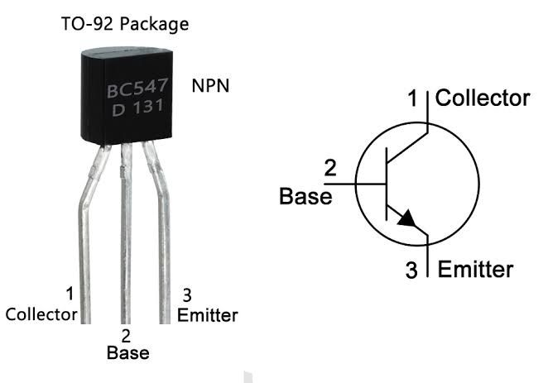
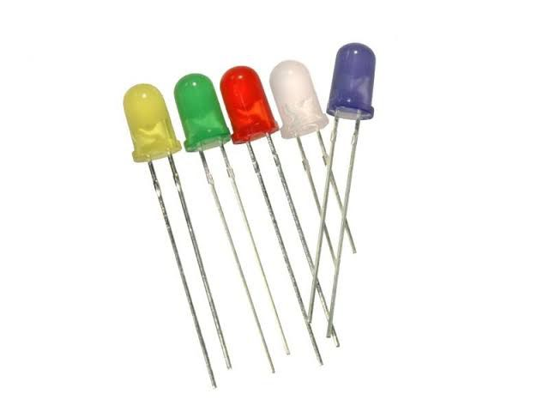
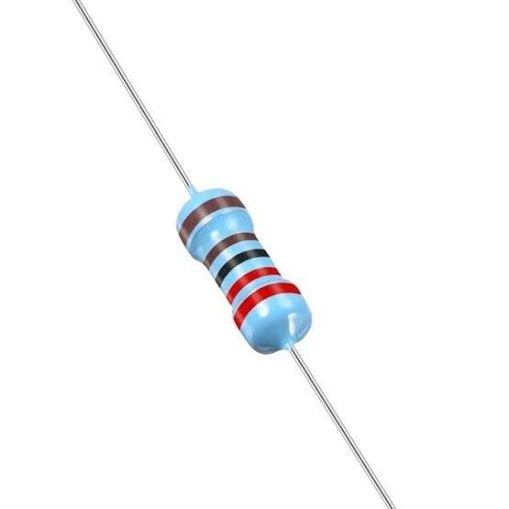
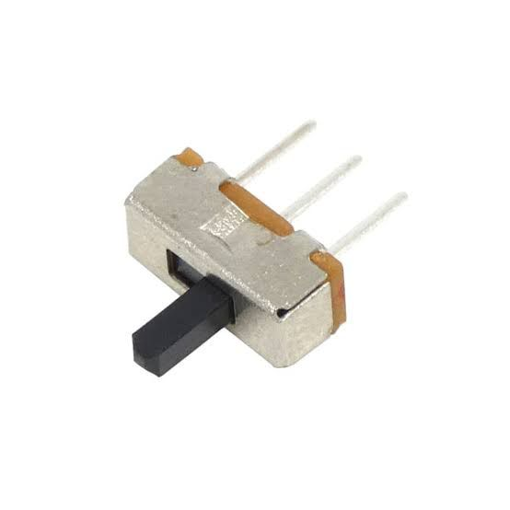
Components
4x BC547 Transistors (NPN, used for switching)
4x LEDs (visual level indicators)
4x 10K Resistors (base resistors for transistor switching, Red-Blue-Yellow-Green)
4x 1K Resistors (LED current-limiting, Red-Blue-Yellow-Green)
1x Buzzer (replaced by a white LED), (5V-12V, for critical level alert)
1x DC Power Supply (5V recommended)
1x Switch (Buzzer control)

Slide 5
How We Built It
The circuit Uses BC547 transistors as logic gates to detect water levels via
conductive probes. Each transistor, with a 10K resistor providing base current
(~830µA), controlled an LED (limited by a 1K resistor at ~7mA) to indicate
low, medium, high, or critical levels. A buzzer(replaced by a white LED), activated at the critical level,
provided an Audio alert. The system was powered by a 5V DC supply, with a
switch for manual control. Testing was conducted in a simulated tank to
verify accurate level detection and reliable operation.

Slide 6
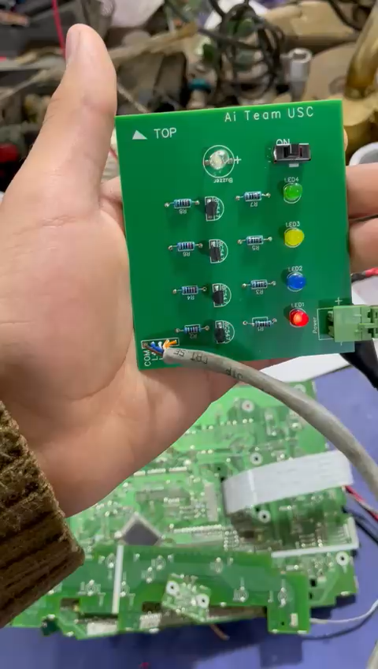
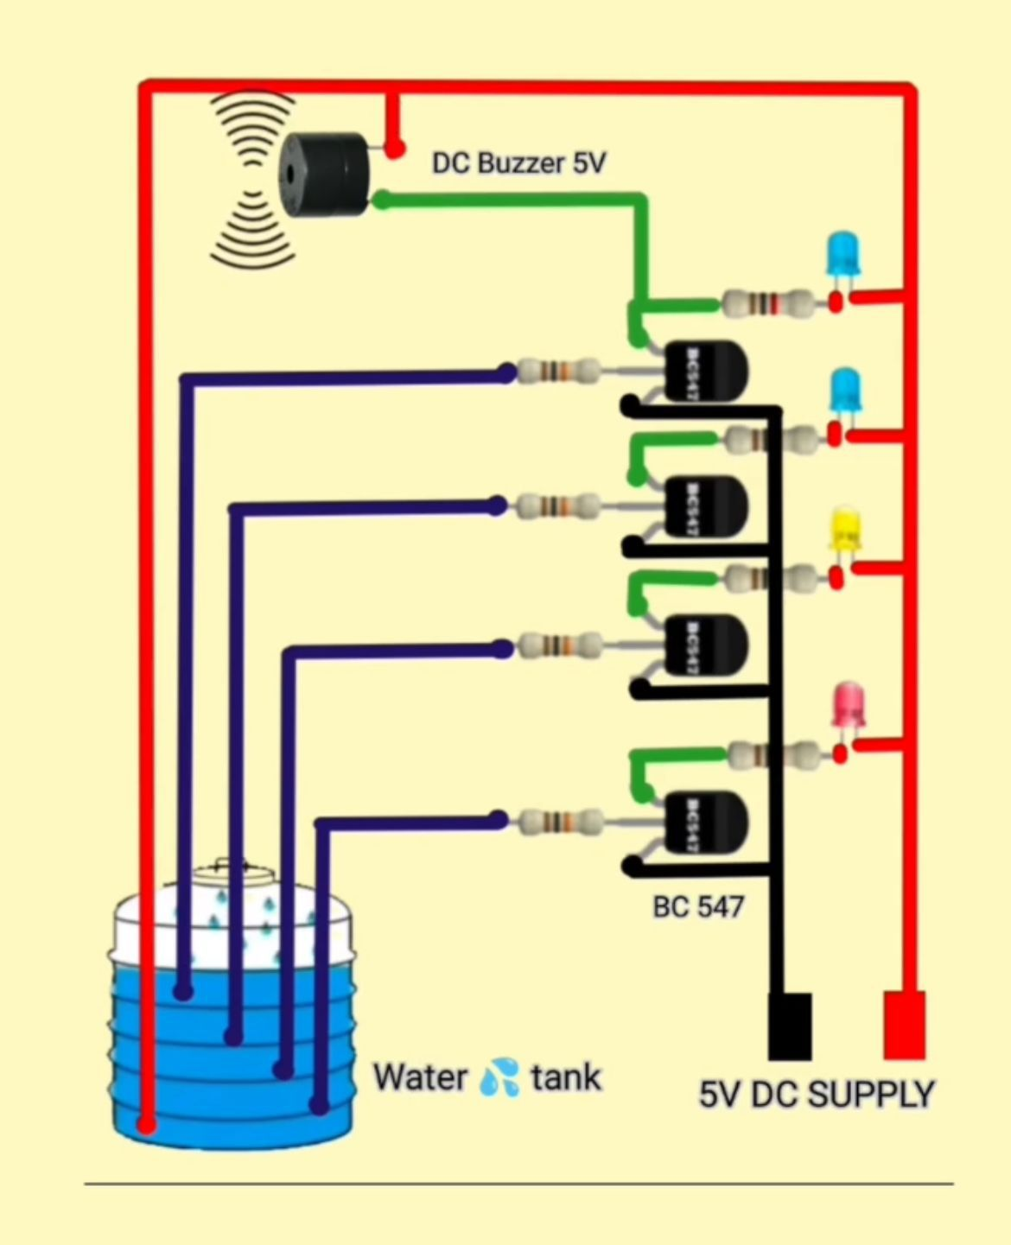
Video Indicates how the project works
Implementation And A circuit Diagram Of The Project

Slide 7
Results
The system successfully indicated four water levels through 4x LEDs, with the buzzer activating Immediately at the Highest level. Challenges included calibrating resistor values to ensure reliable transistor switching and addressing false triggers due to water conductivity variations. The circuit performed as intended, offering a cost-effective solution for water level monitoring.

Slide 8
Conclusion
The logic gates-based water level indicator demonstrated the practical
application of BC547 transistors in a real-world monitoring system.
Completed on time and within scope, the project met all objectives.
Potential enhancements include adding wireless alerts or integrating with automated pump systems.

Slide 9


